Slide 1

Into what will I grow?
The Promised Results of Progressive Sanctification [Spiritual Growth]
Image from spreadingthefame.com

Slide 2
Promised Result: Healing and Freedom
Romans 6.6-7 NIV: “For we know that our old self was crucified with him so that the body ruled by sin might be done away with, that we should no longer be slaves to sin-- because anyone who has died has been set free from sin.”
Galatians 5.16 NET: “But I say, live by the Spirit and you will not carry out the desires of the flesh.”

Slide 3
Promised Result: Healing and Freedom
1 Corinthians 10.13 NIV: “No temptation has overtaken you except what is common to mankind. And God is faithful; he will not let you be tempted beyond what you can bear. But when you are tempted, he will also provide a way out so that you can endure it.”

Slide 4
Promised Result: Intimacy with God
Proverbs 3.32 NET: “For one who goes astray is an abomination to the LORD, but he reveals his intimate counsel to the upright.”

Slide 5
Promised Result: Intimacy with God
1 John 1.3-9 NET: “If we say we have fellowship with him and yet keep on walking in the darkness, we are lying and not practicing the truth. But if we walk in the light as he himself is in the light, we have fellowship with one another and the blood of Jesus his Son cleanses us from all sin. If we say we do not bear the guilt of sin, we are deceiving ourselves and the truth is not in us. But if we confess our sins, he is faithful and righteous, forgiving us our sins and cleansing us from all unrighteousness.”

Slide 6
Promised Result: Intimacy with God
John 14.21 NET: “The person who has my commandments and obeys them is the one who loves me. The one who loves me will be loved by my Father, and I will love him and will reveal myself to him.”

Slide 7
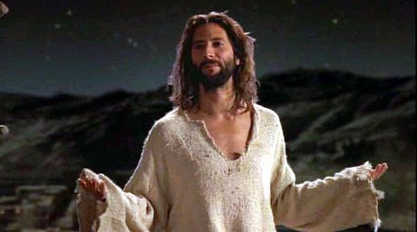
Promised Result: Christ-likeness

Slide 8
Promised Result: Christ-likeness
Galatians 5.19-21 NET: “Now the works of the flesh are obvious: sexual immorality, impurity, depravity, idolatry, sorcery, hostilities, strife, jealousy, outbursts of anger, selfish rivalries, dissensions, factions, envying, murder, drunkenness, carousing, and similar things. I am warning you, as I had warned you before: Those who practice such things will not inherit the kingdom of God!”

Slide 9
Promised Result: Christ-likeness
Matthew 28.19-20: Go make disciples, baptizing and teaching them…
Matthew 22.37-40 NET: “Love the Lord your God with all your heart, with all your soul, and with all your mind. This is the first and greatest commandment. The second is like it: Love your neighbor as yourself. All the law and the prophets depend on these two commandments.”

Slide 10
Promised Result: Christ-likeness
Ephesians 4.15-16 NET: “But practicing the truth in love, we will in all things grow up into Christ, who is the head. From him the whole body grows, fitted and held together through every supporting ligament. As each one does its part, the body grows in love.”

Slide 11
Promised Result: Maturity in Faith
Eph. 4.11-15 NET: “It was he who gave some as apostles, some as prophets, some as evangelists, and some as pastors and teachers, to equip the saints for the work of ministry, that is, to build up the body of Christ, until we all attain to the unity of the faith and of the knowledge of the Son of God– a mature person, attaining to the measure of Christ's full stature. So we are no longer to be children, tossed back and forth by waves and carried about by every wind of teaching by the trickery of
people who craftily carry out their deceitful
schemes. But practicing the truth in love, we will in
all things grow up into Christ, who is the head.”

Slide 12
Promised Result: Maturity in Faith
Ephesians 4.11-15 NET: “It was he who gave some as apostles, some as prophets, some as evangelists, and some as pastors and teachers, to equip the saints for the work of ministry…

Slide 13
Promised Result: Maturity in Faith
Ephesians 4.11-15 NET: “It was he who gave some as apostles, some as prophets, some as evangelists, and some as pastors and teachers, to equip the saints for the work of ministry, that is, to build up the body of Christ, until we all attain to the unity of the faith and of the knowledge of the Son of God– a mature person, attaining to the measure of Christ's full stature.

Slide 14
Promised Result: Maturity in Faith
Ephesians 4.11-15 NET: “It was he who gave some as apostles, some as prophets, some as evangelists, and some as pastors and teachers, to equip the saints for the work of ministry, that is, to build up the body of Christ, until we all attain to the unity of the faith and of the knowledge of the Son of God– a mature person, attaining to the measure of Christ's full stature.

Slide 15
Promised Result: Maturity in Faith
Ephesians 4.11-15 NET: “…to build up the body of Christ, until we all attain to the unity of the faith and of the knowledge of the Son of God– a mature person, attaining to the measure of Christ's full stature. So we are no longer to be children, tossed back and forth by waves and carried about by every wind of teaching by the trickery of people who craftily carry out their deceitful schemes. But practicing the truth in love, we will in all things grow up into
Christ, who is the head.”

Slide 16
Promised Result: Maturity in Faith
Ephesians 4.11-15 NET: “…to build up the body of Christ, until we all attain to the unity of the faith and of the knowledge of the Son of God– a mature person, attaining to the measure of Christ's full stature. So we are no longer to be children, tossed back and forth by waves and carried about by every wind of teaching by the trickery of people who craftily carry out their deceitful schemes. But practicing the truth in love, we will in all things grow up into
Christ, who is the head.”

Slide 17
Promised Result: Maturity in Faith
Hebrews 5.12-14 NET: “For though you should in fact be teachers by this time, you need someone to teach you the beginning elements of God's utterances. You have gone back to needing milk, not solid food. For everyone who lives on milk is inexperienced in the message of righteousness, because he is an infant. But solid food is for the mature, whose perceptions are trained by practice to discern both good and evil.”

Slide 18
Promised Result: Maturity in Faith
2 Timothy 3.16-17 NET: “Every scripture is inspired by God and useful for teaching, for reproof, for correction, and for training in righteousness, that the person dedicated to God may be capable and equipped for every good work.”

Slide 19
Promised Result: Fruit of the Spirit
Galatians 5.22-23 NASB: “But the fruit of the Spirit is love, joy, peace, patience, kindness, goodness, faithfulness, gentleness, self-control; against such things there is no law.”

Slide 20
Promised Results:
 Healing and Freedom
 Intimacy with God
 Christ-likeness
 Maturity in Faith
 Fruit of the Spirit

Slide 21
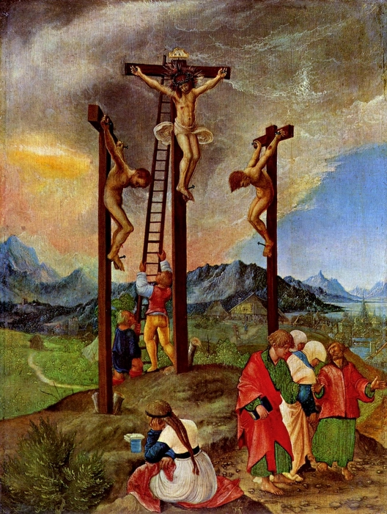
“Crucifixion of Christ”
Albrecht Altdorfer
AD 1480-1538
Courtesy of
Vanderbilt University

